Slide 1
Real estate
Price predicting model

Slide 2
Finding the type of model to build
Supervised learning.
Regression task.
Batch learning i.e., already have the data and make the model.

Slide 3
Libraries used
Pandas: For data MANIPULATION AND ANALYSIS.
Matplotlib: for plotting graphs.
NumPy: for performing different operations on arrays.

Slide 4
Tasks performed
Train test splitting
Looking for correlations
Attribute combinations
Missing attributes
Creating a pipeline
Selecting the desired model for real estate
Evaluating the model
Using better evaluation technique ie., cross validation
Saving the model
Testing the model on test data
Using the model

Slide 5

Train and test splitting

Slide 6
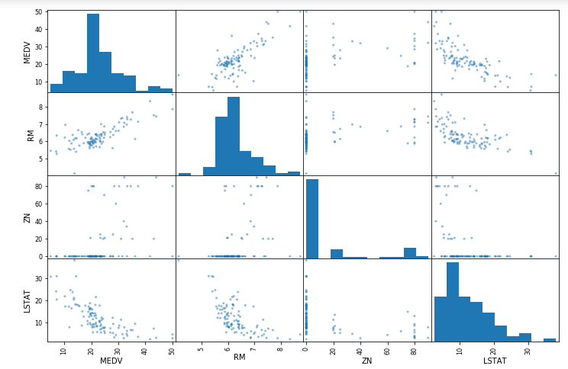
Looking for correlations

Slide 7
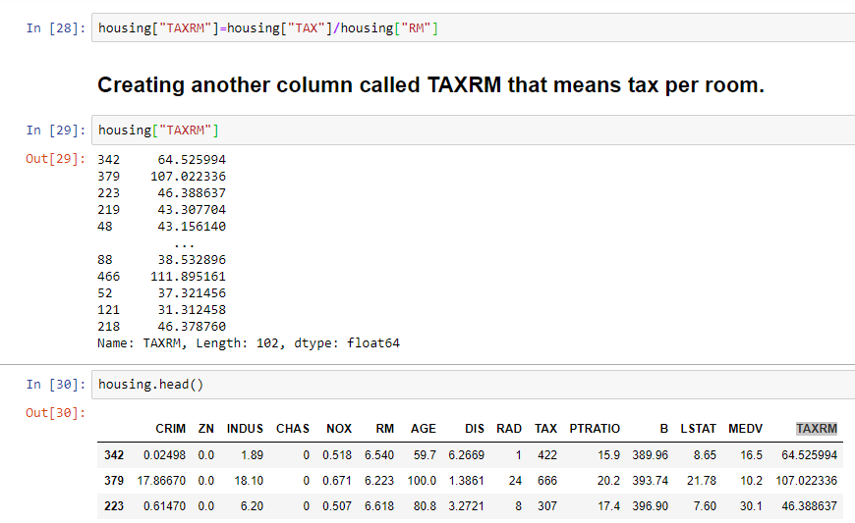
Attributes combination

Slide 8
Missing attributes
To take care of the missing attributes:
1. Get rid of the missing data points.
2. Get rid of the whole attribute.
3. Set the value to some value( 0 , mean or median).

Slide 9

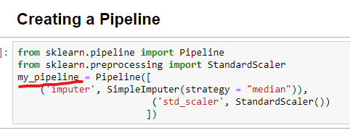
Creating a pipeline
Pipelines work by allowing for a linear sequence of data transforms to be chained together.

Slide 10
Selecting the desired model for real estate
Try out few models like Decision tree, linear regression, random forest regressor. And choose the model that gives prediction close to correct.

Slide 11
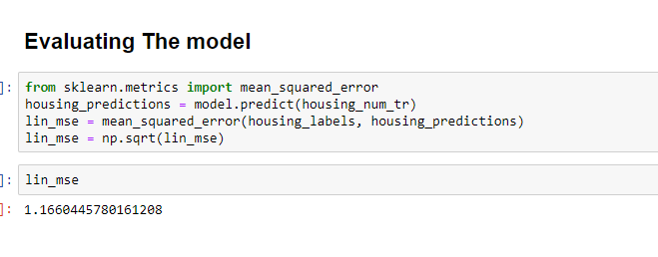
Evaluating the model

Slide 12



Thank you

